Slide 1
Working with Cloud Development Services
Course : Mobile Cloud Computing
Year : 2015

Slide 2
Subtopics
Cloud service types
Vertical cloud services
FeedHenry.com
Appcelerator.com
appMobi.com

Slide 3
Cloud service types
Infrastructure-as-a-service — You get virtual infrastructure software, such as operating systems, databases, and file storage. Amazon and Rackspace are good examples.
Platform-as-a-service — You get a prebuilt execution environment for your code, and the service looks after all the infrastructure elements. The Heroku cloud environment for Ruby web apps is the archetypal example here.
Software-as-a-service — You do not need to write any code, you just use an online service for a particular purpose, such as email. Gmail and Hotmail are perfect examples.

Slide 4
TOPIC | KEY CONCEPTS
Cloud service types | The term cloud development service covers a wide range of online services and offerings. It is useful to break these down into three broad categories: services that provide infrastructure, services that provide a software platform, and services that provide a vertical user-oriented online service. The key differences are in the level of eff ort you need to expend to configure and maintain the different kinds of services and the level of customization that you can achieve.

Slide 5
TOPIC | KEY CONCEPTS
Vertical cloud services | Cloud development service providers often deliver their services as discrete modules of functionality, with diff erent pricing models. These functional modules address various vertical business requirements, such as e-commerce or analytics. Cloud development service providers allow you to pick and choose the set of modules that you need for each app. The benefi t is that you do not need to develop the functionality that the module provides, and you don’t need to provision the storage or computation resources required.

Slide 6
TOPIC | KEY CONCEPTS
FeedHenry.com | The FeedHenry mobile cloud service offers a full cloud environment for building mobile apps using HTML5. FeedHenry also offers a server-side code execution platform so you can run your entire service from within FeedHenry. This service is targeted more at enterprise developers and may be suitable if you have a large client.
Appcelerator.com | The Appcelerator service allows you to build mobile apps for iPhone and Android against native user interface components using JavaScript. This is done by providing you with an extensive proprietary API. Appcelerator does not have a general-purpose cloud hosting facility, but it does offer cloud modules to integrate with social media.

Slide 7
TOPIC | KEY CONCEPTS
Bitbucket.org | Provide free unlimited private git repositories with some terms
NewRelic.com | Web & Mobile Application Analytics
Parse.com | Web & Mobile Application Analytics, Advance Push Service
CloudFlare.com | Protect your site against DDoS, SQL Injection, etc

Slide 8
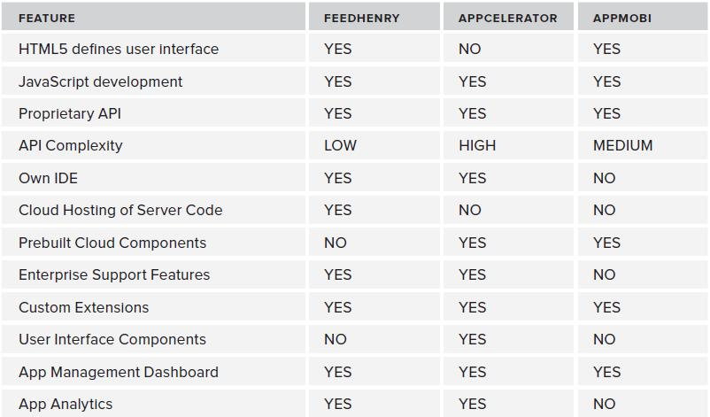
Summary

Slide 9
References
Rodger, Richard. (2012). Beginning Mobile Application Development in the Cloud, Chapter 11 : Working with Cloud Development Services
Strategy and Design Services for Cloud Infrastructure : http://www.youtube.com/watch?v=wbZHvpPGL7o
Develop New Cloud-Designed Applications with Windows Azure SQL : http://www.youtube.com/watch?v=FnKftjkytkE
Azure for Virtualization, Development, and Cloud Services : http://www.youtube.com/watch?v=oD9T38maNKE

Slide 10
TERIMA KASIH

